Slide 1


Keynote Basics!
Notes:
IF time - keynote template for activities to explore and play to begin with
Show them how to make their own folder ‘on my ipad’ for all their work

Slide 2


App Prototype Design
Lesson 1: Plan

Slide 3
Learning objectives
To be able to format all elements on keynote
To understand the impact of User Interface (UI) and User Experience (UX)
To be able to add buttons, text and hyperlinks to create a functioning App prototype

Slide 4
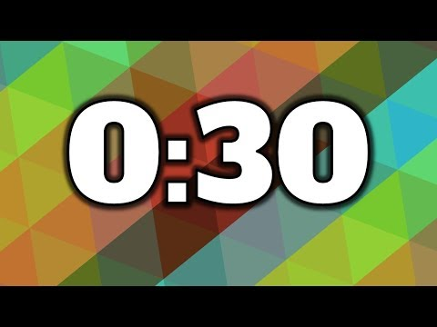
What are Apps and why do we have them?
Name as many as you can in 30 seconds!
Notes:
Timed-pair-share to discuss the starter question whilst you airdrop the workbook to the students
Students to name as many apps as they can in 30 seconds

Slide 5

What is this app?
What can you do on it?
Who uses this app?
What problems does it solve?
Notes:
Table top discussion about the question prompt. Get the students to embed their understanding of Problem, purpose, audience.
E.g. Want food late at night but don’t want to go out? Grab will deliver your food to your door through the app. It’s aimed at adults who are too busy to cook etc.

Slide 6

Your brief from Mr Jamie!

Slide 7

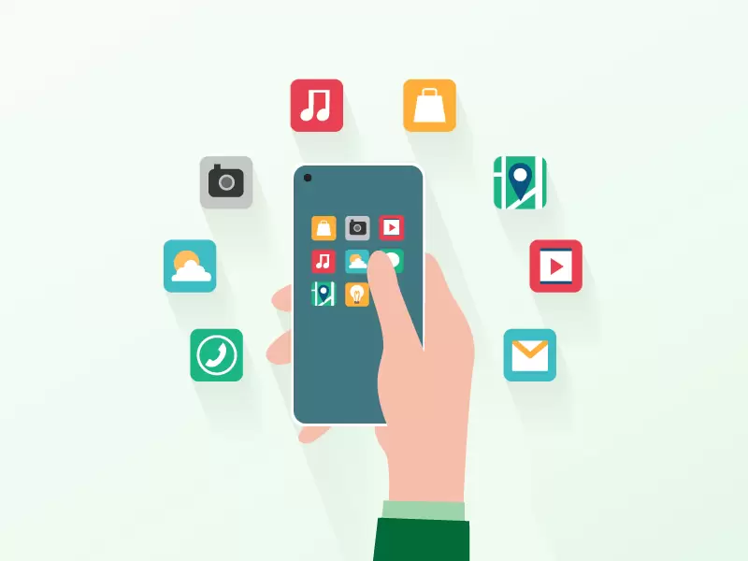
What does Mr Jamie and Ms Emily want us to produce?
What pages can we add?
Notes:
Discuss the different technology available in smartphones and tablets and how they are used to solve problems with apps.
Grab- uses mobile data, GPS and Maps to navigate from place-to-place

Slide 8
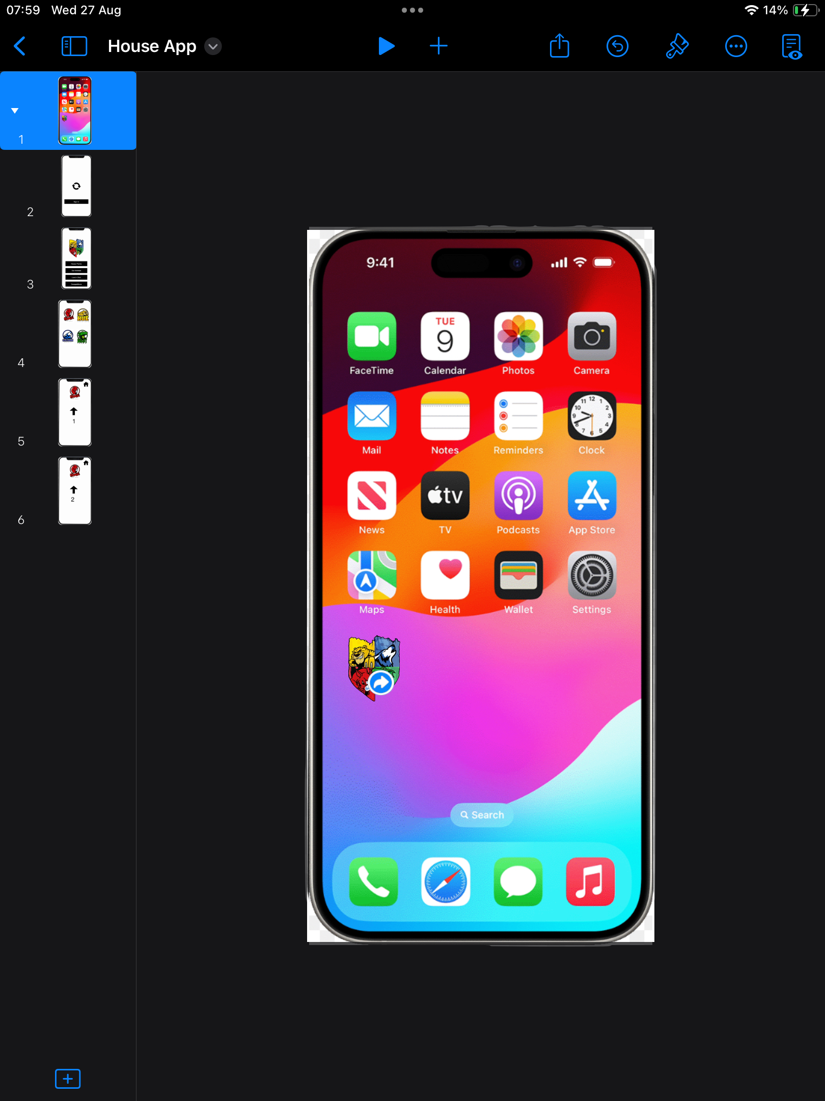
Check out the base template that The House Leaders would like you to work off…

Slide 9
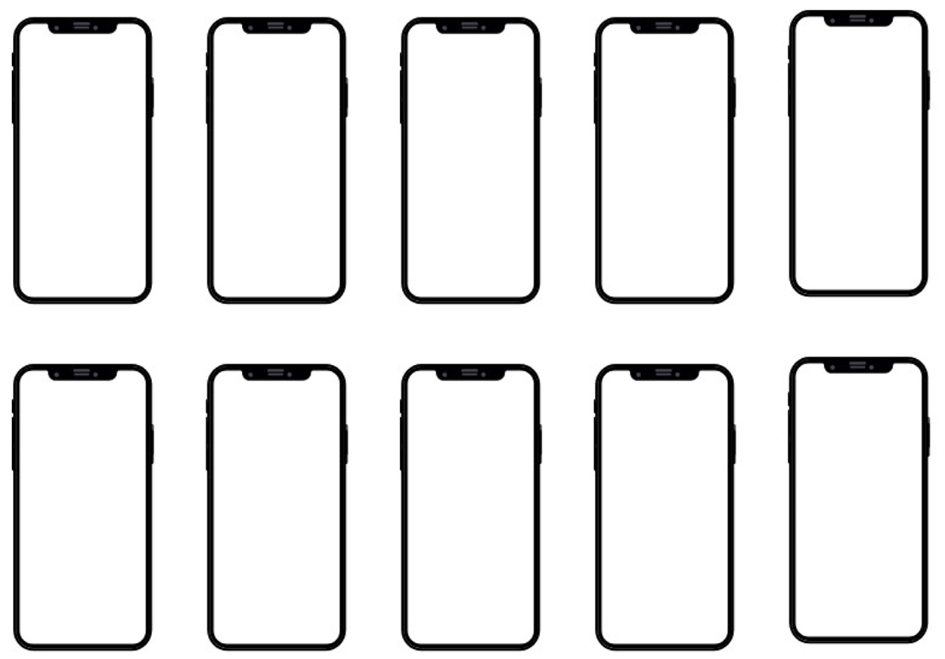

Notes:
Draw on board the navigation lines in a coloured pen - they plan in pairs on paper - 15 mins

Slide 10
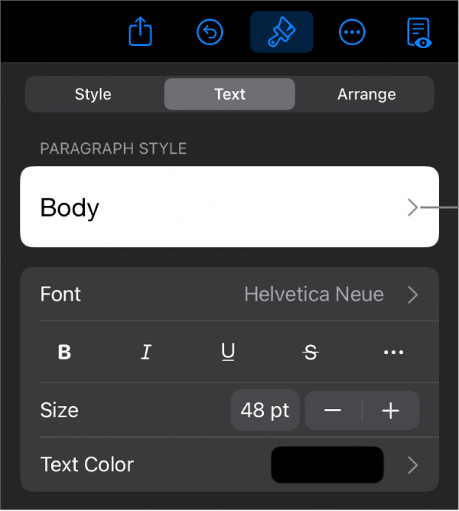
Let’s get started:
School ipad
Duplicate template
Rename
Begin formatting!

Slide 11
App Prototype Design
Lesson 2&3: Design

Slide 12
Learning objectives:
To be able to format all elements on keynote
To understand the meaning of User Interface (UI) and User Experience (UX)
To be able to add buttons, text and hyperlinks to create a functioning App prototype

Slide 13

User Interface Vs User Experience
Notes:
What do they think they mean from the image?

Slide 14

What is UI?
What you see: UI is the visual part that you interact with.
Interactive parts: It includes all the buttons you tap, the icons you see, the pictures, and the colors on a screen.
Example: The colorful buttons and clear pictures in a kids' drawing app are all part of its UI.

Slide 15
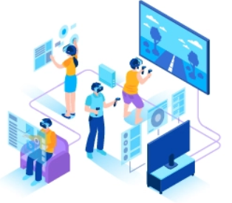
What is UX?
How you feel: UX is all about making sure using a product, app, or website feels good and is easy for you.
The whole journey: It's about the entire journey of your interaction, how you navigate from when you first start to when you finish.
Example: A game that's fun and doesn't make you get stuck is a good example of good UX.

Slide 16
Top tips for UI:
Are your buttons obvious?
Can you create one complete page for house points then duplicate it for the other houses?
Are your pages too busy?
Is your font large enough?
Notes:
Give them another 20 mins on UI and then move onto UX and navigation

Slide 17
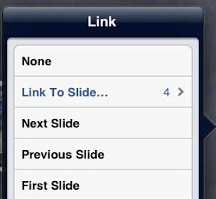

How to add links and basic animation:
Splash Page:
Build in - Twirl
After transition

Slide 18
Top tips for UX:
Is it obvious where to click?
Can you navigate back to the home page or do you get stuck on a page?
How can you sign out of the app?
Test it with a friend, can they work out how to use your app?
Notes:
Give them another 20 mins on UI and then move onto UX and navigation

Slide 19

Finish one page for house points for 1 house with links and a home button…
then
duplicate!

Slide 20
App Prototype Design
Lesson 4: Test & Present

Slide 21
Can you remember that they stand for and what the difference is?

Slide 22
Learning objectives:
To be able to format all elements on keynote
To understand the meaning of User Interface (UI) and User Experience (UX)
To be able to add buttons, text and hyperlinks to create a functioning App prototype

Slide 23
Mild
Medium
Hot
Self Evaluation
The buttons on my home screen are clear
I have some links set up for navigation
Some of my buttons are different sizes and don’t match the others
I have followed the brief that Mr Jamie gave us
The buttons on my homescreen are all the same shape
I have a back button to return to my home screen from each page
My pages are clear and simple
I have a mix of different transitions between my pages that are sometimes a bit confusing
Most of my links work smoothly
I have added animation to the arrow on splash page
I can sign out of my app back to slide 1
I have thought carefully about the colour of my buttons
I have simple transitions between my pages
Other people can navigate my app smoothly

Slide 24
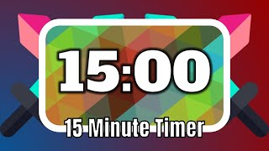
You have 15 minutes to finish!

Slide 25

Learning objectives
To be able to evaluate my work
To be able to make a screen recording
Step 1: Airdrop to your own ipad!

Slide 26
Presentation
Make a screen recording describing how your app works and all the different features. Your screen recording must:
Be engaging
Clear
Explain exactly what your app does
What is the target audience
What technology it uses
What would you charge to download the app

Slide 27
Mild
Medium
Hot
Self Evaluation
The buttons on my home screen are clear
I have some links set up for navigation
Some of my buttons are different sizes and don’t match the others
I have followed the brief that Mr Jamie gave us
The buttons on my homescreen are all the same shape
I have a back button to return to my home screen from each page
My pages are clear and simple
I have a mix of different transitions between my pages that are sometimes a bit confusing
Most of my links work smoothly
I have added animation to the arrow on splash page
I can sign out of my app back to slide 1
I have thought carefully about the colour of my buttons
I have simple transitions between my pages
Other people can navigate my app smoothly

Slide 28

Sharing your work to Seesaw
Complete the Seesaw activity
Adding your app brief and screen recording
Once uploaded, complete your self evaluation

Slide 29
End of unit quiz!

